Slide 1


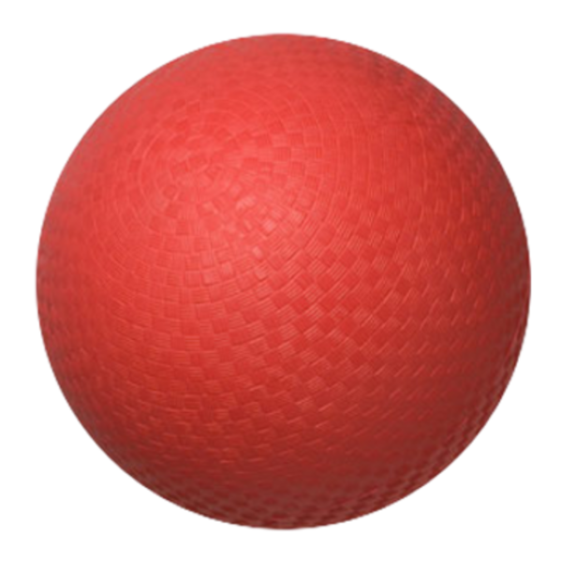
Dodgeball Z
A really alright game pitch by Josh Lowry

Slide 2
Rules
-Getting hit by the ball results in a point for the other player and the players are reset.
-First to 5 points wins.
-Catch the ball right before it hits your character.
-When caught the ball is held for a preset amount of time.
-After that time the ball is released in the direction the character is facing.
-Each time the ball hits a wall the ball speeds up.

Slide 3
Target Audience
-Dodgeball Z targets the players who enjoy competitive games that only exist in a local setting.
-Smash Bros Melee, Nidhogg.

Slide 4
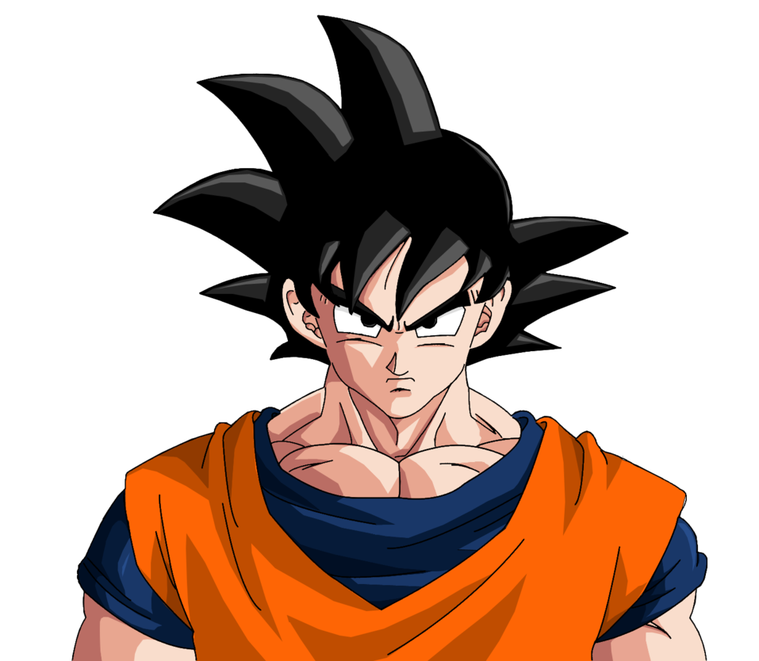
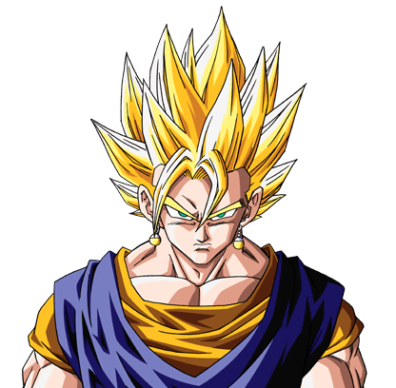
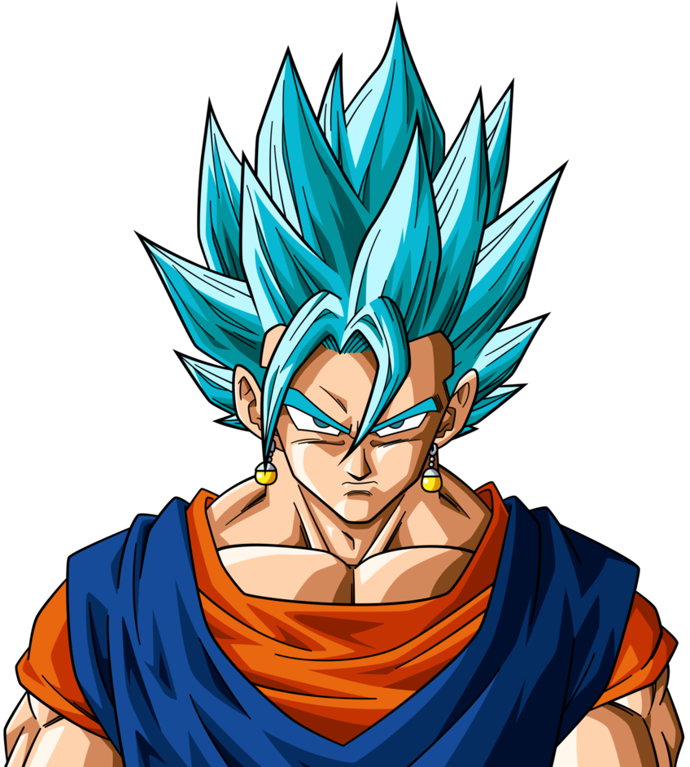
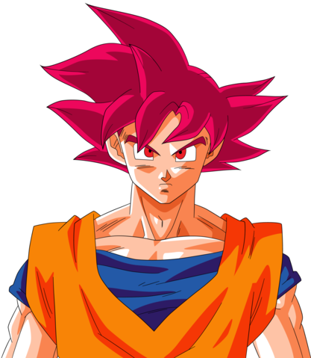
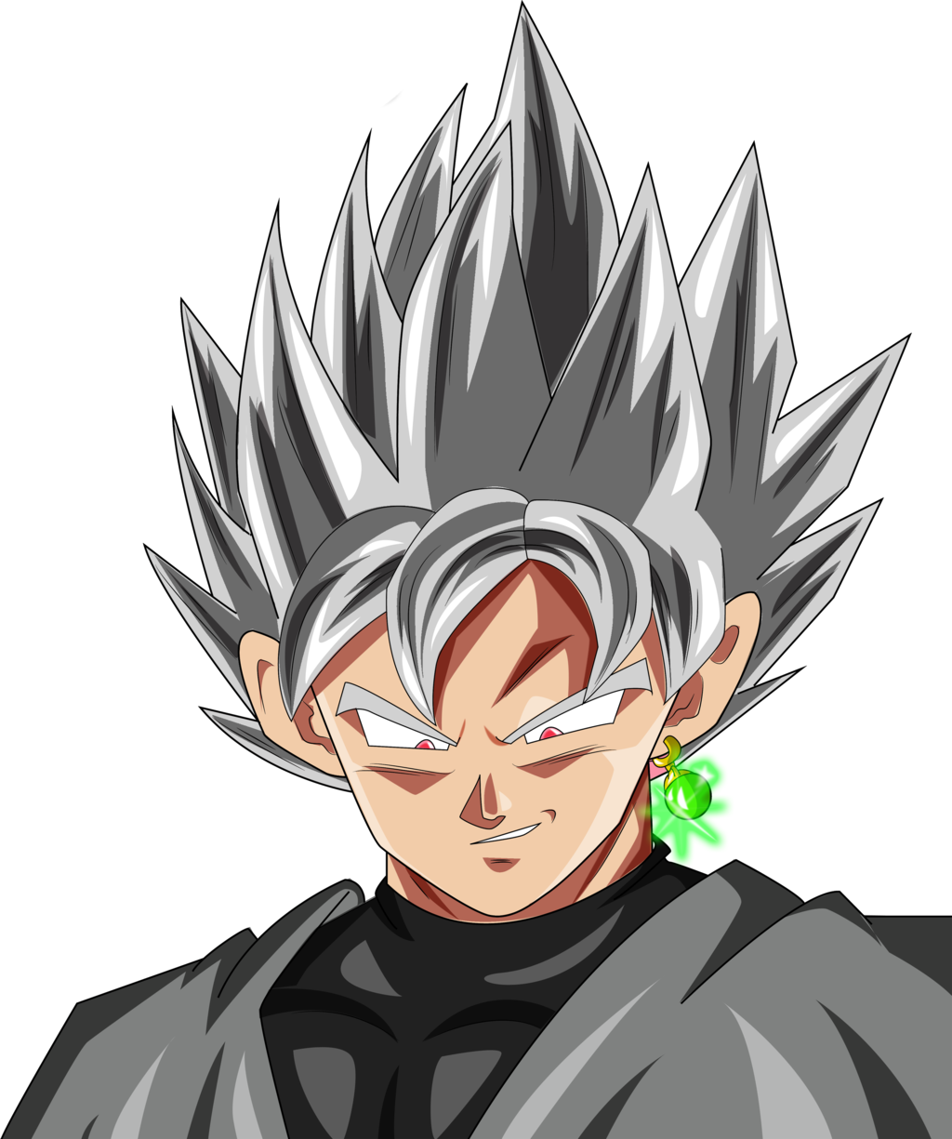
Charging Ki
Charging Ki will allow you to use abilities.
Your character’s hair will change depend on they’re ki level.

Slide 5
Abilities
-Teleport a short distance.
-Send out an energy beam that temporarily acts as a wall.
-Abilities can be used while holding the ball.
-Using abilities has a Meter Burn effect. You spend one power level for a powerful abilities.
Ability

Slide 6
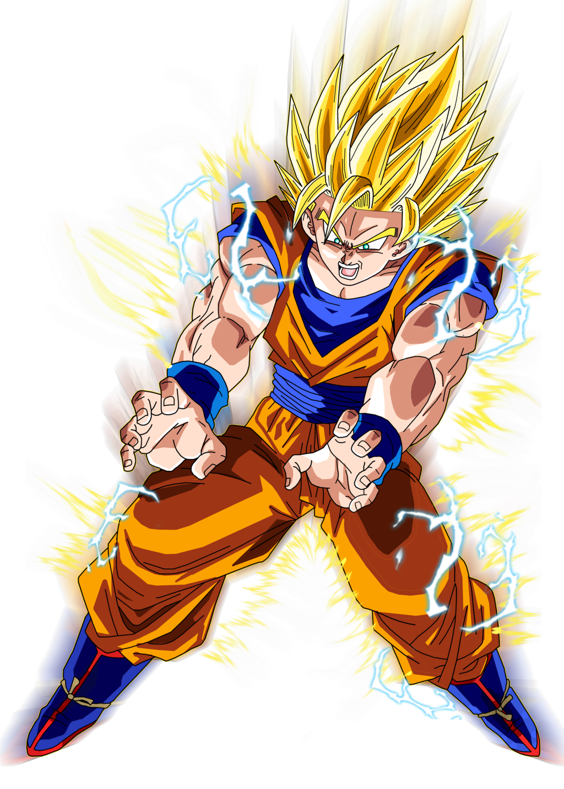
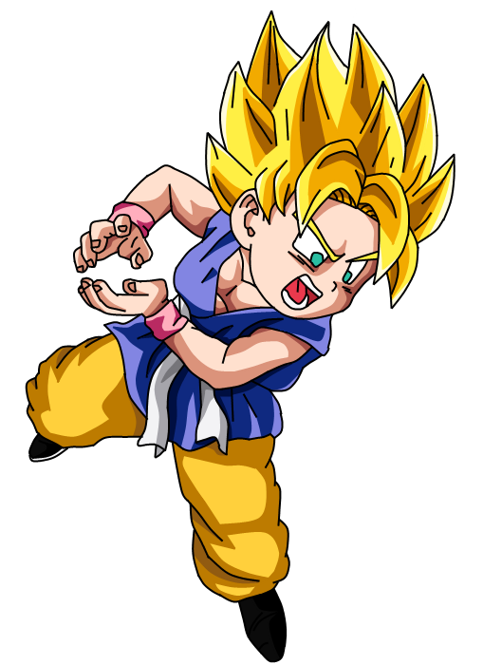
Energy Blast

Slide 7
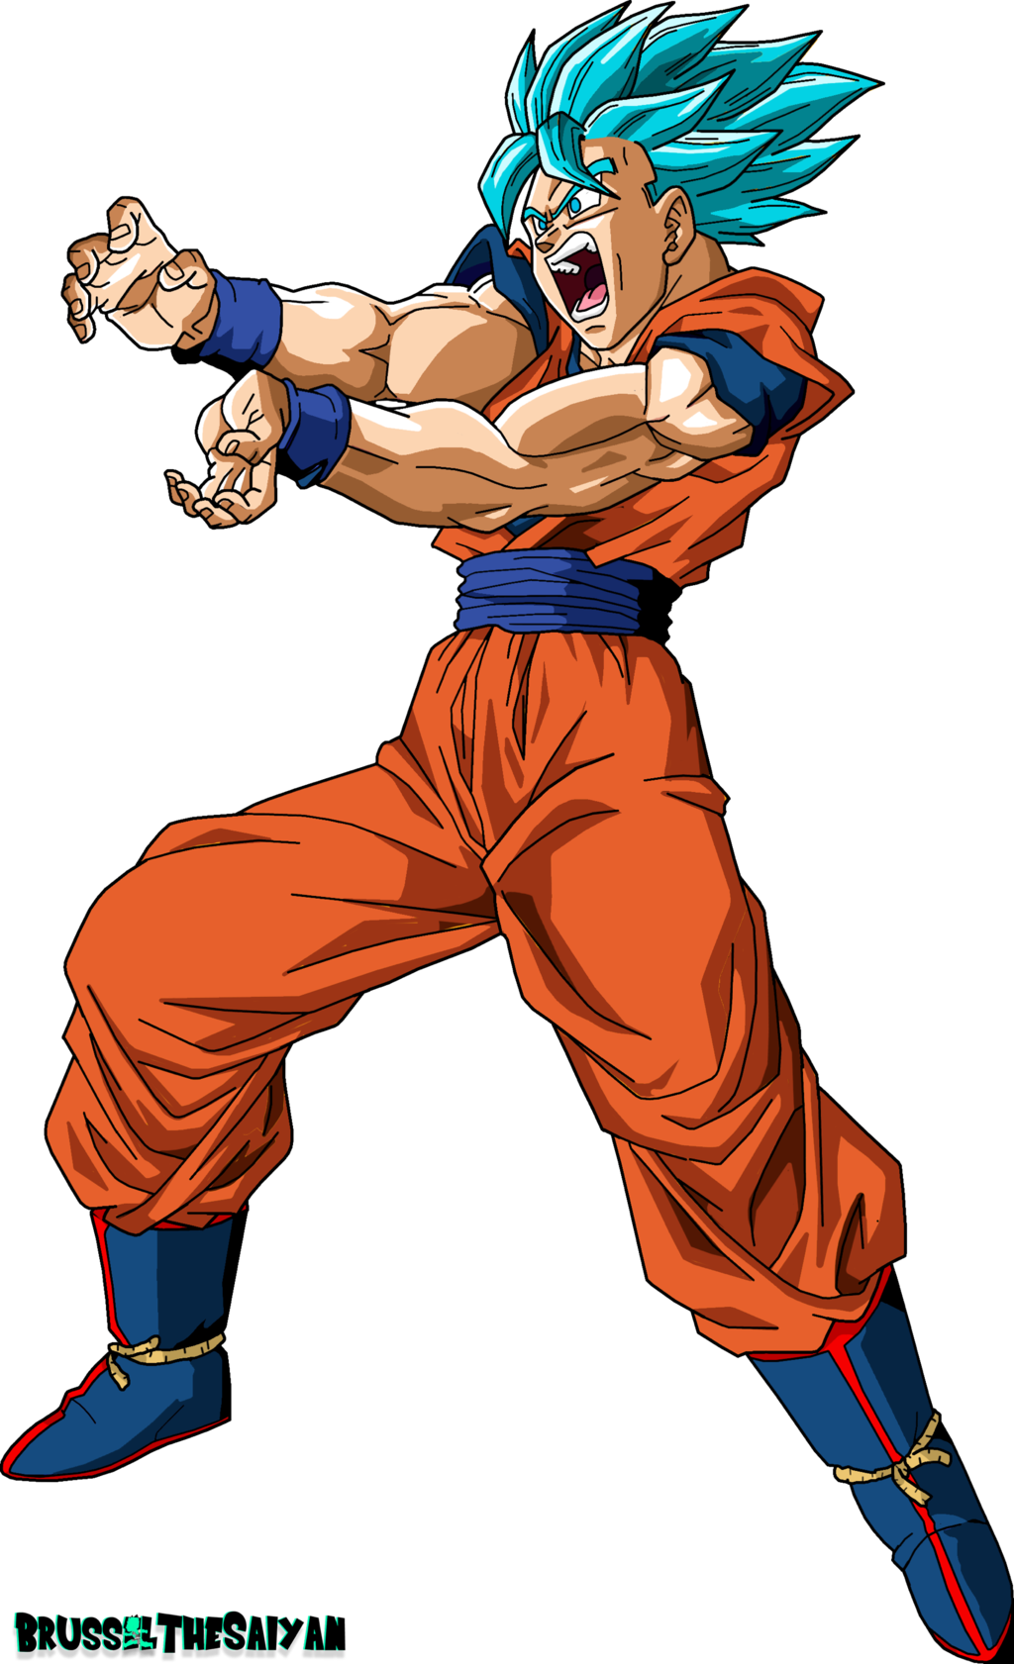
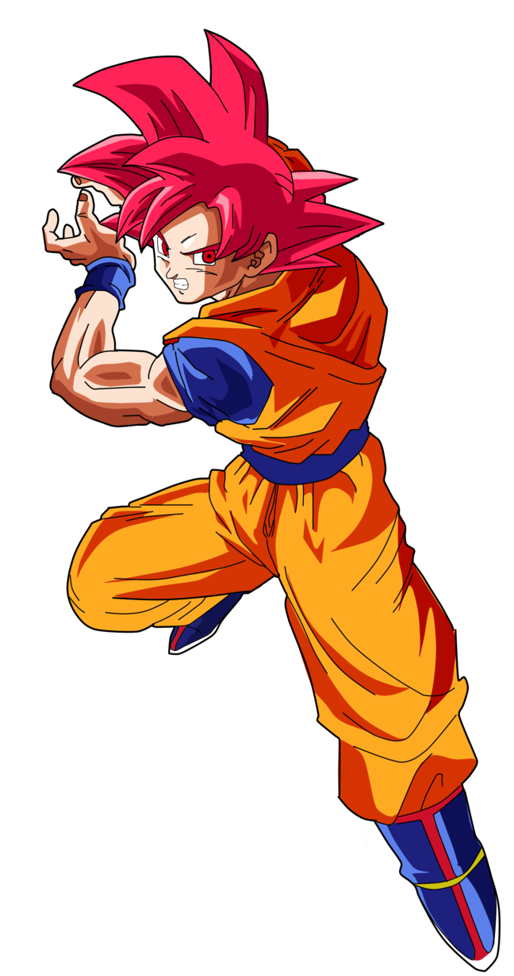
Teleport

Slide 8
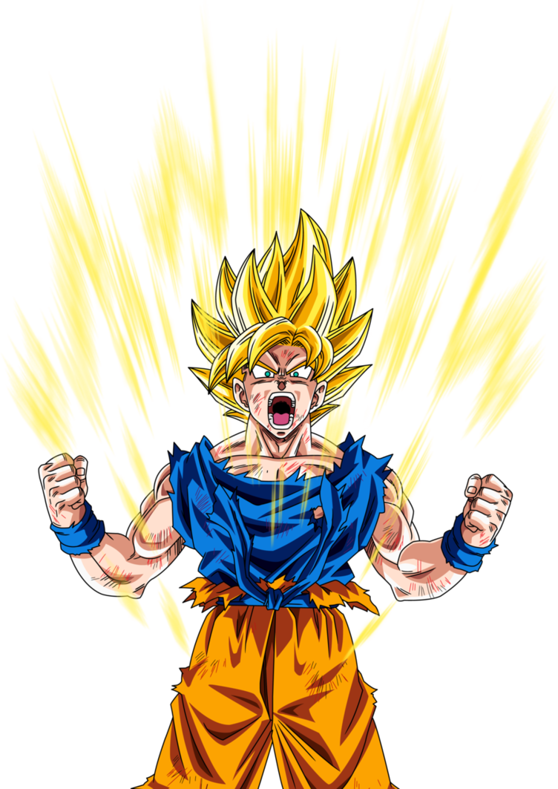
Three Pillars
-Visuals
-Competitiveness
-UI Design

Slide 9
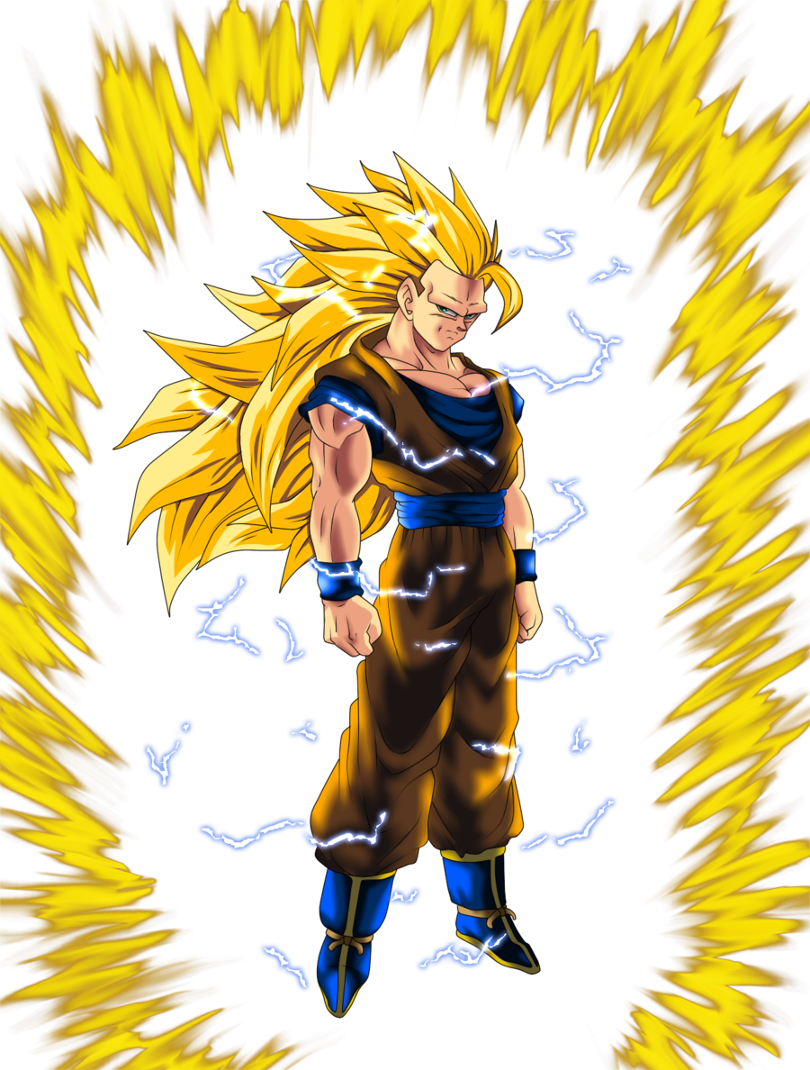
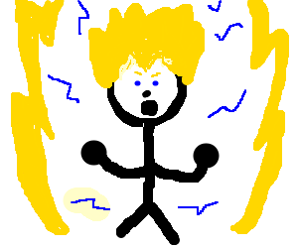
Art Style
Not These:
Something Like This:

Slide 10
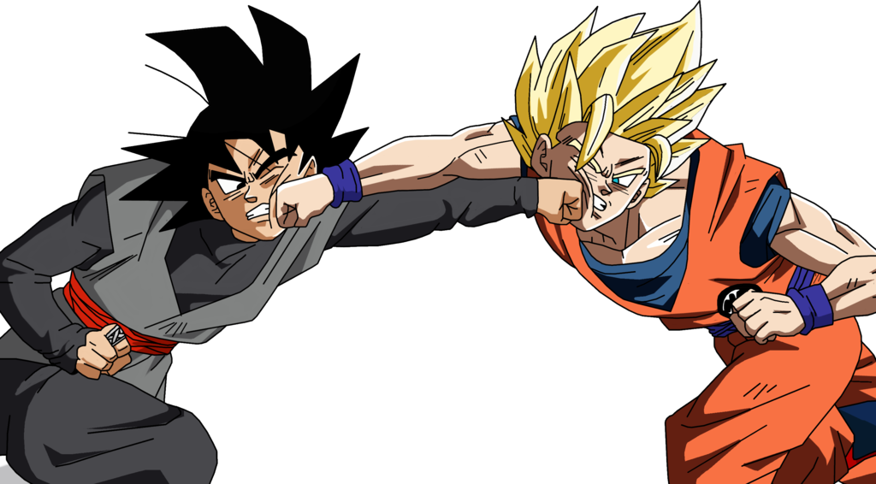
Competitiveness
-Local Multiplayer
-Low Floor, High Ceiling
-Abilities provides opportunities for savage outplays

Slide 11
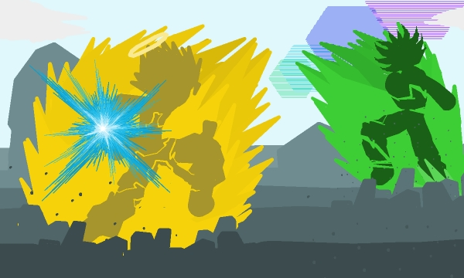
UI Design
It is important to complement competitive gameplay with easy to read UI Design.
-Power Level
-Ball Trajectory
-Separate Characters

Slide 12
Game Cycle
When the game is opened until it is closed.
When the actual match starts until it ends.
The time between each point scored.
The time between the ball being caught.

Slide 13
Scope
I believe we can finish this game. But...
Cons:
-Pretty Programming Intensive.
-Based on Existing IP
-Not sure how hard it is to program for controllers.
Pros:
-Tried to take what I remember learning in 1801 and make a game with that.
-DragonBall isn’t crucial to the gameplay.

